Slide 1


Session-1 Introduction to Go Programming
-------------------------------------------------
By Shadab Akhtar

Slide 2
--------------------------------------------------------------------------------------------------
Module Introduction
--------------------------------------------------------------------------------------------------
In this module, we will cover
What is Golang ?
Basics of programming
Key essentials of Golang
Advantages of Golang
Comparison of the Go language, C, C++, Java, and Python

Slide 3
--------------------------------------------------------------------------------------------------
What is Golang ?
--------------------------------------------------------------------------------------------------
An open-source programming language supported by Google
Build simple, secure, scalable systems with Go
Easy to learn and great for teams
Built-in concurrency and a robust standard library
Large ecosystem of partners, communities, and tools
--------------------------------------------------------------------------------------------------
Basics of programming
--------------------------------------------------------------------------------------------------
Irrespective of the programming language you choose to learn, the basic concepts of programming are similar across languages.
Some of these concepts include:
Variable Declaration
Basic Syntax
Data Type and Structures
Flow Control Structures (Conditionals and loops)
Functional Programming
Object-Oriented Programming
Debugging
IDEs and Coding Environments

Slide 4
Variable declaration:
--------------------
Variables are containers for storing data values, a memory location for a data type. Variables are created using a declaration or keyword that varies across languages.
Variable names are usually alphanumeric, that is, they contain a-z and 0-9. They can also include special characters like underscore or the dollar sign
Variables can hold values of any data type supported by the programming language. This value may change during program execution
Basic syntax:
--------------
Every programming language has its syntax, and you must learn the fundamental syntax of the language you are learning.
Syntax refers to the set of rules that define the structure of a language. It is almost impossible to read or understand a programming language without its syntax.
For example, let us declare a variable named greet and assign the value “Hello World” to it:

Slide 5
C++
---------
#include <iostream>
using namespace std;
int main() {
// your code goes here
string greet;
greet = "Hello World";
cout << greet;
return 0;
}
JavaScript
------------------
let greet = "Hello World";

Slide 6
Java
----------
String greet = "Hello World";
Python
------------
greet = "Hello World";
Data types and structures:
----------------------------
Data types refer to the classification of data. The most common data types include:
String
Boolean (true or false)
Numbers, which includes integers (whole numbers from 1) and floating-point numbers (decimal-base)
Characters (includes single alphabets or numbers)
Arrays (a collection of data, usually of the same data type)

Slide 7
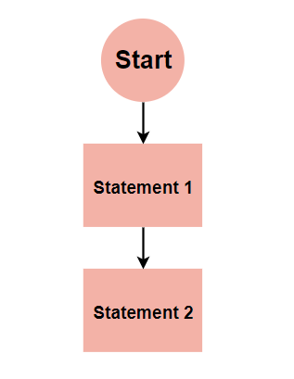
Flow control structures:
----------------------
Flow Control Structures are the fundamental components of computer programs
They are commands that allow a program to “decide” to take one direction or another.
There are three basic types of control structures: sequential, selection, and iteration:
--------------------------------------------------------------------------
Sequential:
-----------
The most basic control flow is sequential control flow. It involves the execution of code statements one after the other. A real-world example is following a cooking recipe

Slide 8
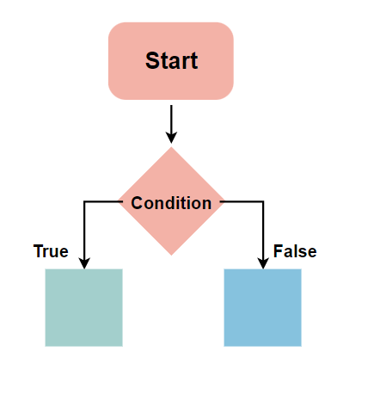
Selection (conditionals):
----------------------
The basic premise of selection flow control is, the computer decides what action to perform based on the result of a test or condition equalling true or false.

Slide 9
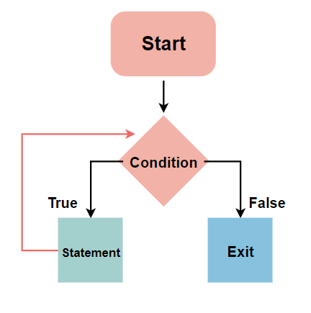
Iteration (Loops)
-----------------
A loop is a programming structure that allows a statement or block of code to be run repeatedly until a specified condition is no longer true (will return Boolean, true or false). It is one of the most powerful and fundamental programming concepts

Slide 10
------------------------------------------------------------------------------------------------
Key essentials of Golang
------------------------------------------------------------------------------------------------
Here are some key features of Go:
-------------------------------
Simplicity: Go is designed to be easy to learn and use. Its syntax is simple and straightforward, making it a good choice for beginners and experienced programmers alike
Concurrency: Go has built-in support for concurrency, allowing developers to write efficient and scalable code for multicore and distributed systems
Garbage collection: Go has automatic memory management, which frees developers from having to worry about memory allocation and deallocation
Fast compile times: Go has a fast compiler, which makes it easy to iterate quickly during development
Cross-platform support: Go can be compiled to run on many different platforms, including Windows, Linux, and macOS
Strong typing: Go is a statically typed language, which helps catch errors at compile time rather than at runtime
Go has a large and growing community of developers and is used by many well-known companies, including Google, Uber, and Dropbox.

Slide 11
------------------------------------------------------------------------------------------------
Advantages of Golang
------------------------------------------------------------------------------------------------
Flexible– It is concise, simple and easy to read.
Concurrency– It allows multiple process running simultaneously and effectively.
Quick Outcome– Its compilation time is very fast.
Library- It provides a rich standard library.
Concurrency: Go provides excellent support for concurrency, making it easy to write code that can run multiple tasks simultaneously. This is achieved through Goroutines and Channels, which allow you to write code that can run multiple operations at the same time.
Performance: Go is designed to be fast and efficient, with a focus on performance and low memory usage. This makes it well-suited for building high-performance network services, as well as for solving complex computational problems.
Simplicity: Go has a straightforward syntax and a simple type system, making it easy to learn and use, even for people with no prior programming experience.
Garbage Collection: Go has built-in garbage collection, which automatically manages memory for you. This eliminates the need for manual memory management, reducing the likelihood of memory leaks and other bugs that can arise from manual memory management.
Statically Typed: Go is a statically typed language, which means that types are determined at compile time. This provides stronger type safety and makes it easier to catch type-related bugs before they occur

Slide 12
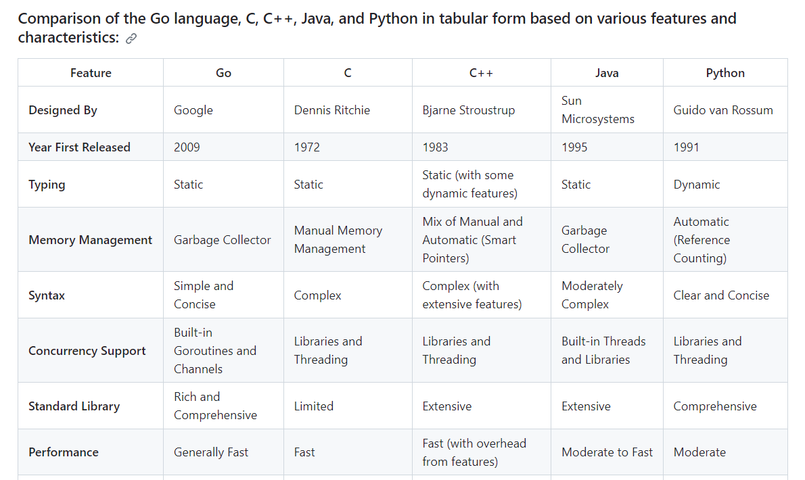

Slide 13
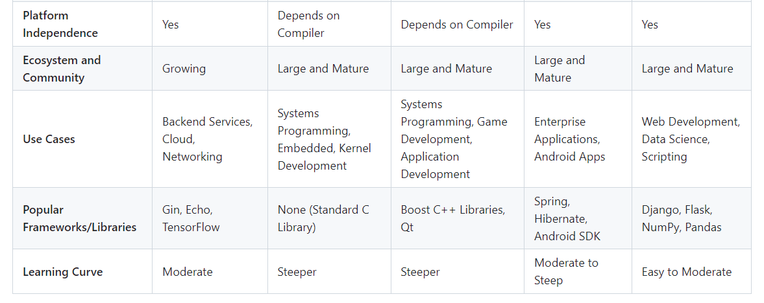

Slide 14
--------------------------------------------------------------------------------------------------
Module Summary
--------------------------------------------------------------------------------------------------
In this module, we have covered
-------------------------------
What is Golang ?
Basics of programming
Key essentials of Golang
Advantages of Golang
Comparison of the Go language, C, C++, Java, and Python

Slide 15


